Slide 1
Deer Hunter Success Index
James Erickson
GIS 5571

Slide 2
Agenda
Intro
Abstract/Problem Statement
Methods
Results
Verification
Discussion/Conclusion

Slide 3
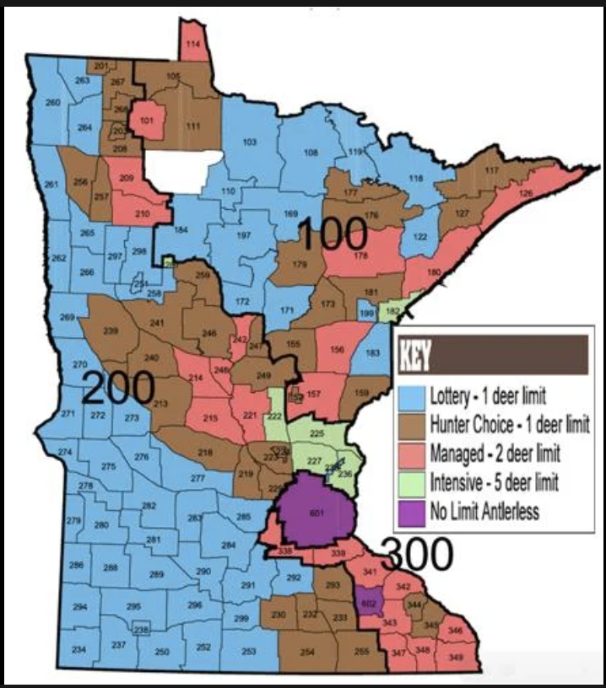
Introduction
I have deer hunted in MN for the last 8 years in various parts of the state
I wanted a way to quantify how good/bad different zones are in MN

Slide 4
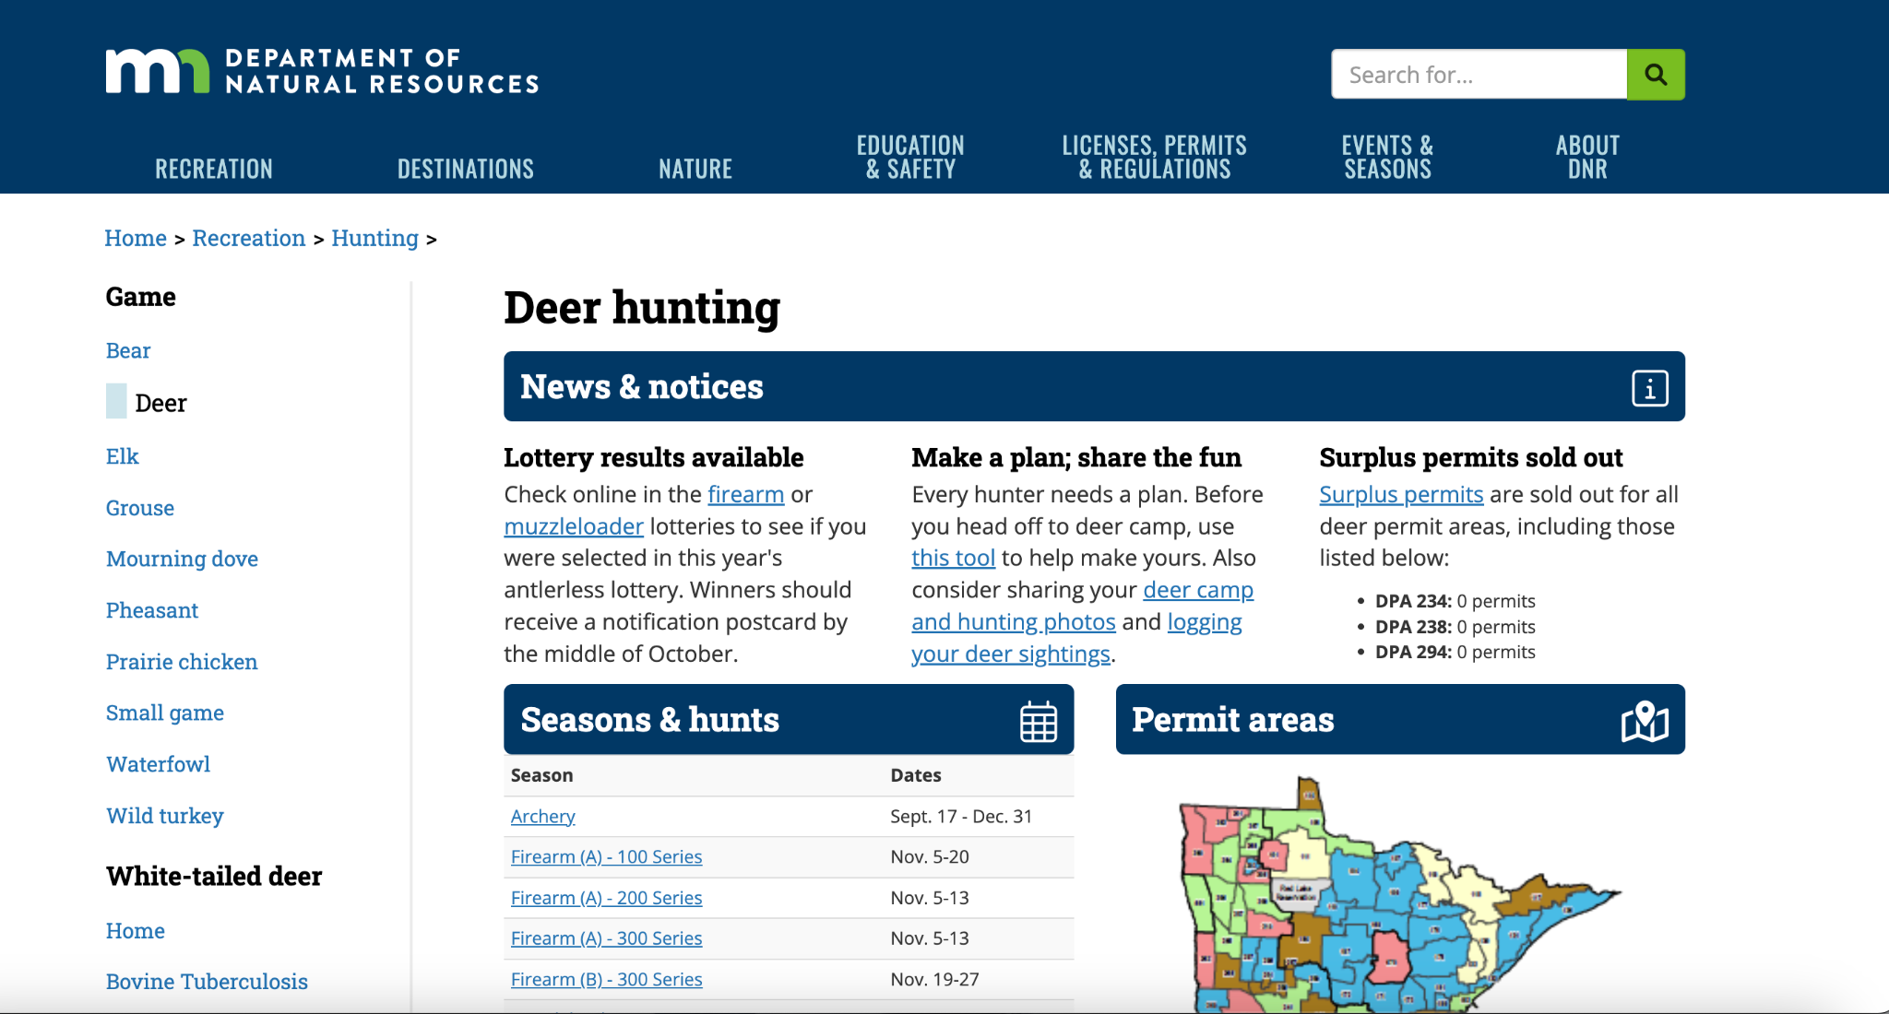
Abstract
Easy to use index to quantify hunter success
Combines resources from MN DNR using MN Geospatial Commons
Cost Surface uploaded to a web map for accessibility
Initial accuracy assessment 78%

Slide 5
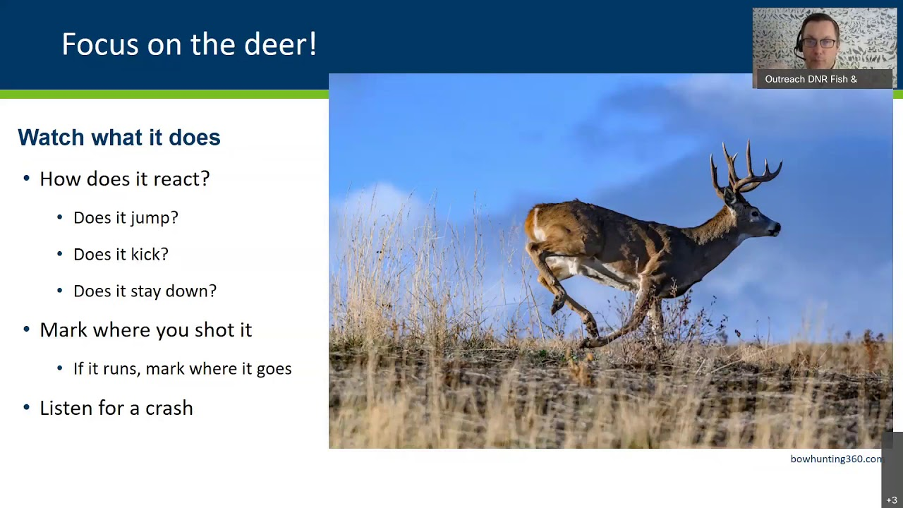
Problem
Many resources for hunters
Not combined into a single site
Not easy to access

Slide 6
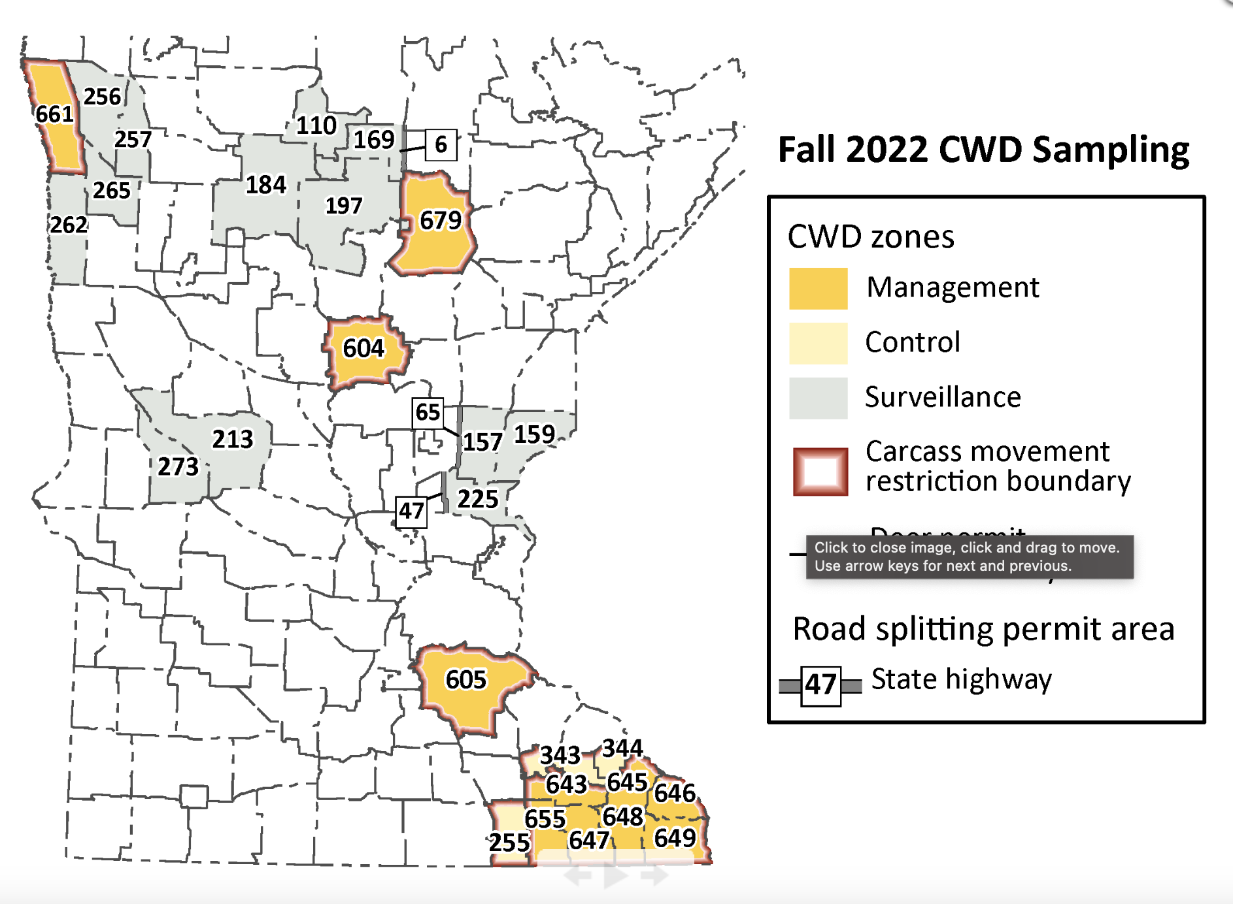
Data
Historical Success (2021 and 2020)
Land Use
DEM (slope)
Chronic Wasting Disease (CWD)
Zones

Slide 7
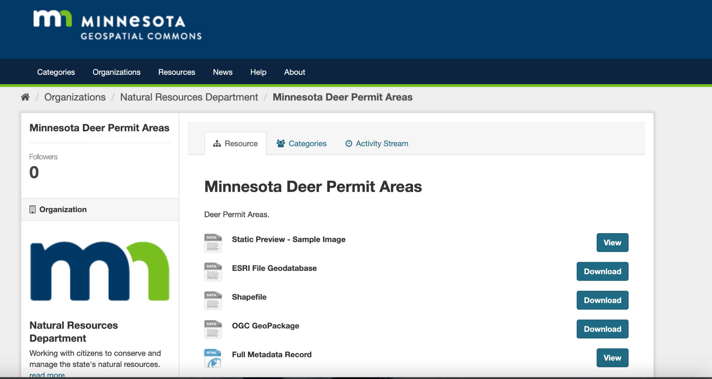
ETL/Pipeline
Most came from Geospatial Commons
CWD Data
JPEG to PDF to csv (manually)
Joining Data to Blank Rasters
Success
CWD
All in NAD 1983 UTM 15N
Had to be converted to WGS84 for export to web map

Slide 8
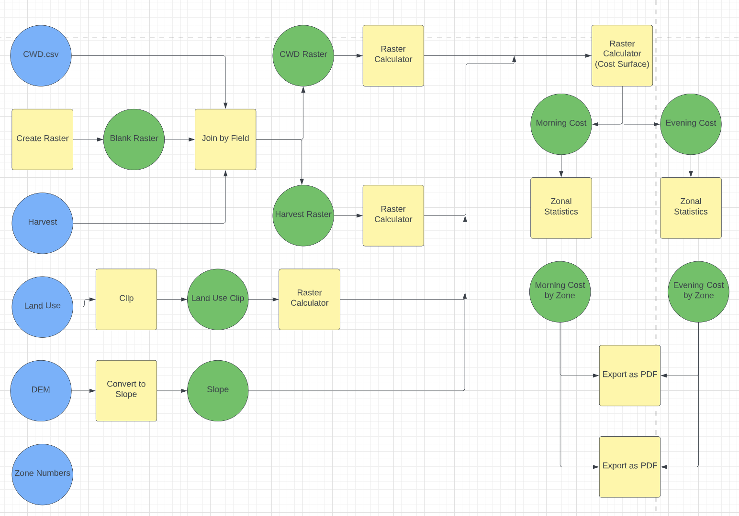
Data Flow Diagram

Slide 9
Cost Surface Generation
Talked with friends and family to determine weight
Small sample size of 6
General consensus that historical success was most important and slope least
CWD was of particular importance to this project so it was assigned a higher weight than land use
Parameters
Success is defined as greater than 50%
Morning is defined as 60 minutes prior to sunset, Evening as 1pm to 60 minutes after sunrise
Linear Model (Generation 1)
Cost (morning) = (slope) + 3(success) +1.5(land use) +2(CWD)
Cost (evening)= (-slope) + 3(success) +1.5(land use) +2(CWD)

Slide 10
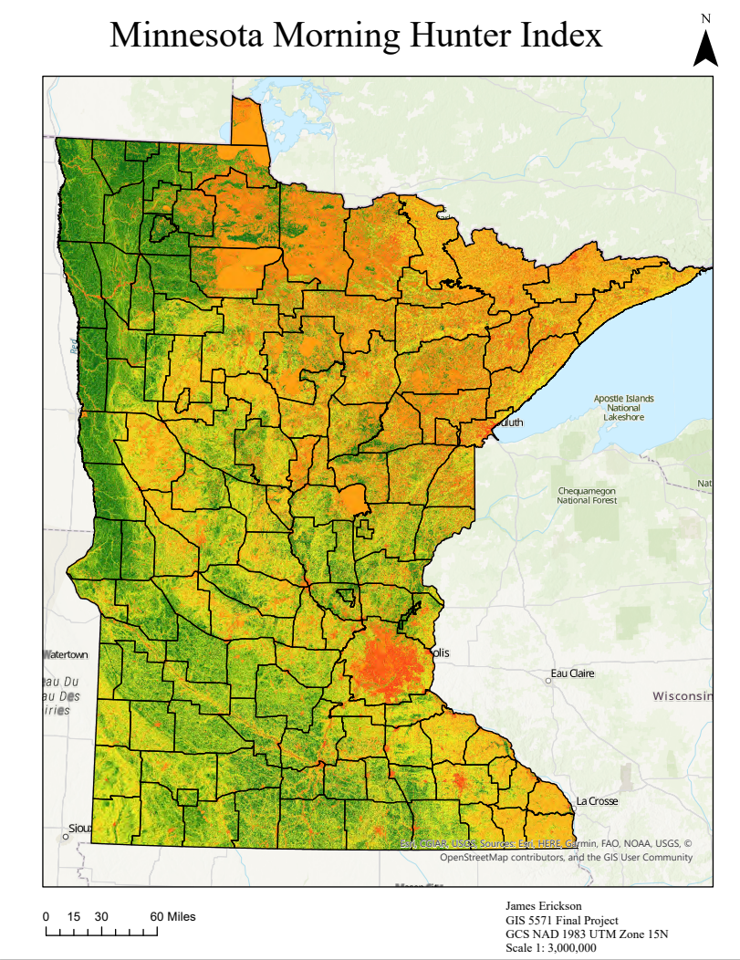
Results - Morning

Slide 11
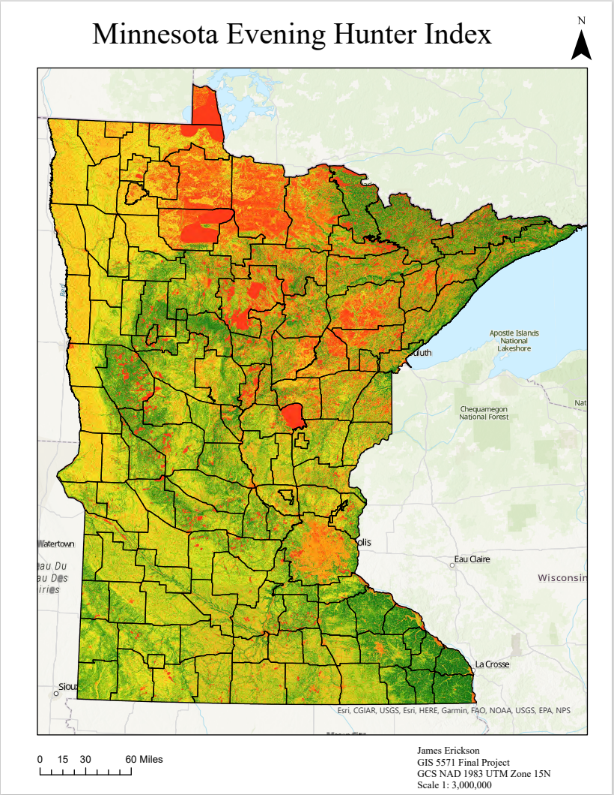
Results - Evening

Slide 12
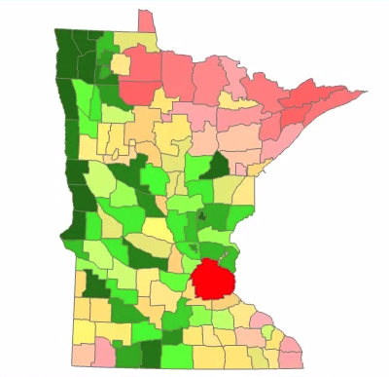
Morning by Zone

Slide 13
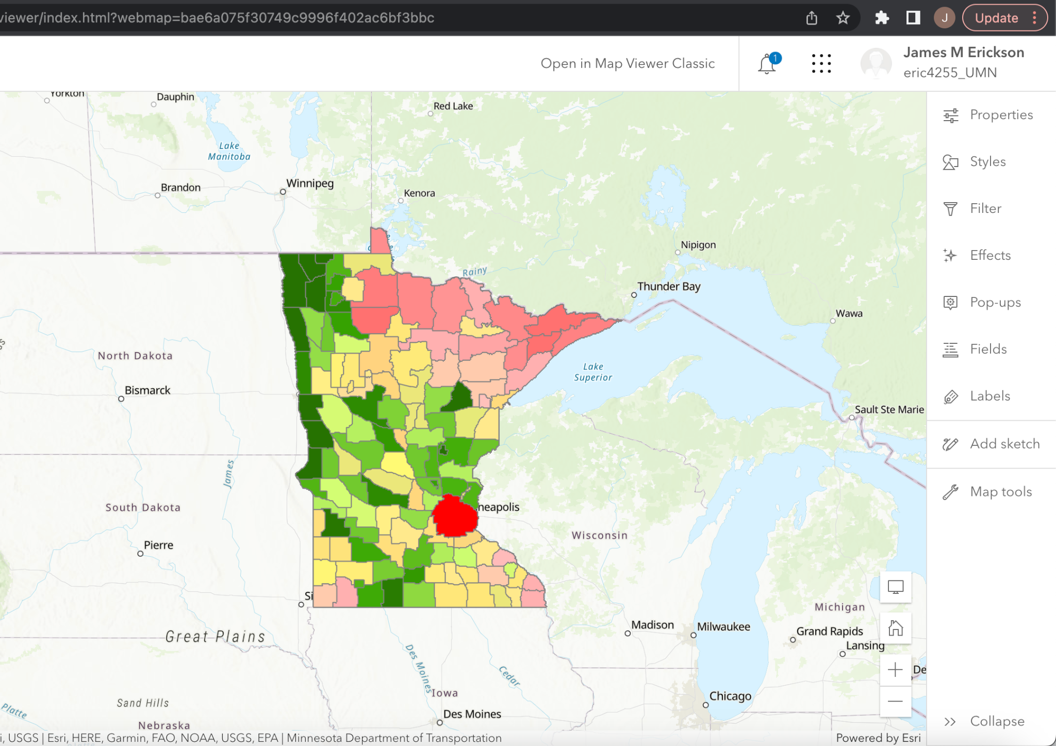
Results - Webmap

Slide 14
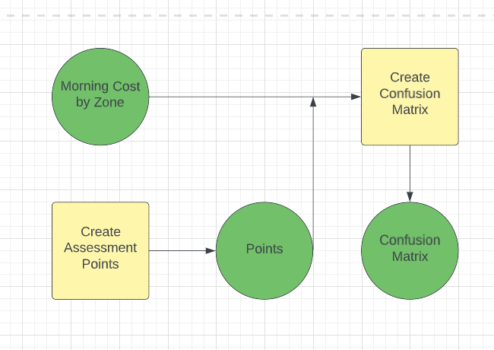
Data Flow - Verification

Slide 15
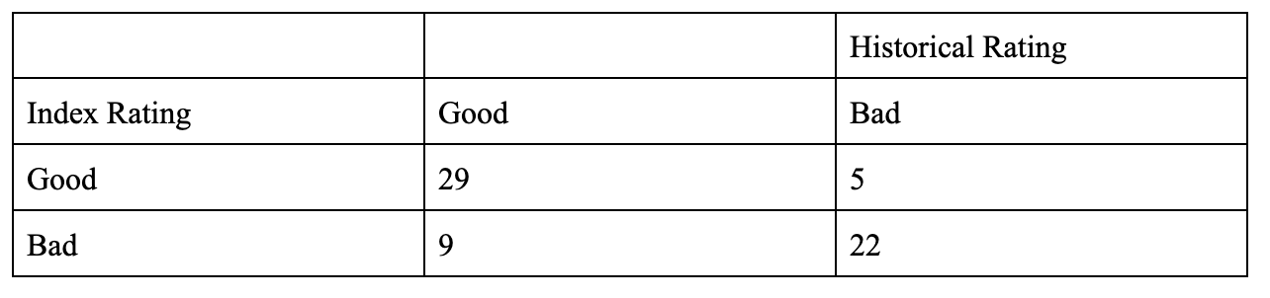
Verification
Compared my index’s zonal score against the 2020 hunter success data
Created 65 points for the 130 zones, randomly created
Index success is defined as the zone being rated higher than 50% and the zone having a success rate of higher than 50%
Overall accuracy (Good Good + Bad Bad) of 78%

Slide 16
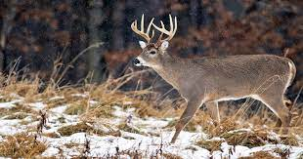
Sensitivity Analysis/Limitations
The sensitivity of a category is directly proportional to its assigned weight
Limited by one year of hunter success data
Weight value is limited by small sample size
Improvements would include years of historical data, weather data, rut data and real time harvest updates
Significantly increase processing requirements
Future Model: Cost (morning) = (slope) + 3(success) +1.5(land use) +2(CWD) +2(weather information) +2.5(rut cycle) +1.5(nearby harvest)

Slide 17
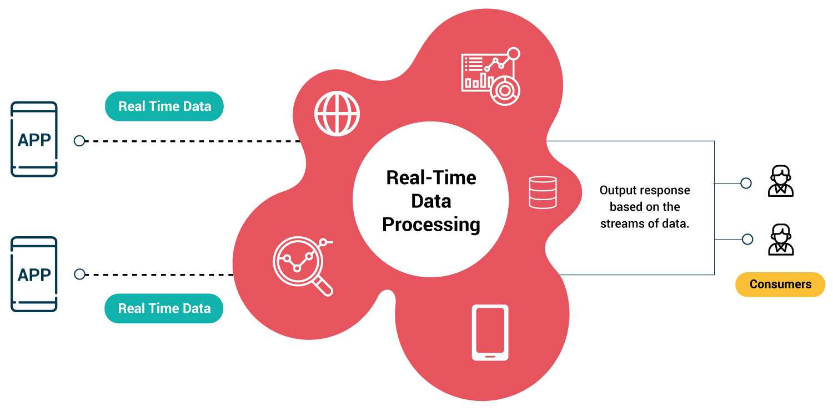
Conclusion
Used skills from every lab
Can definitely see how I could take project to the next level
Real time data updates
Inclusion of weather data
More complex model

Slide 18
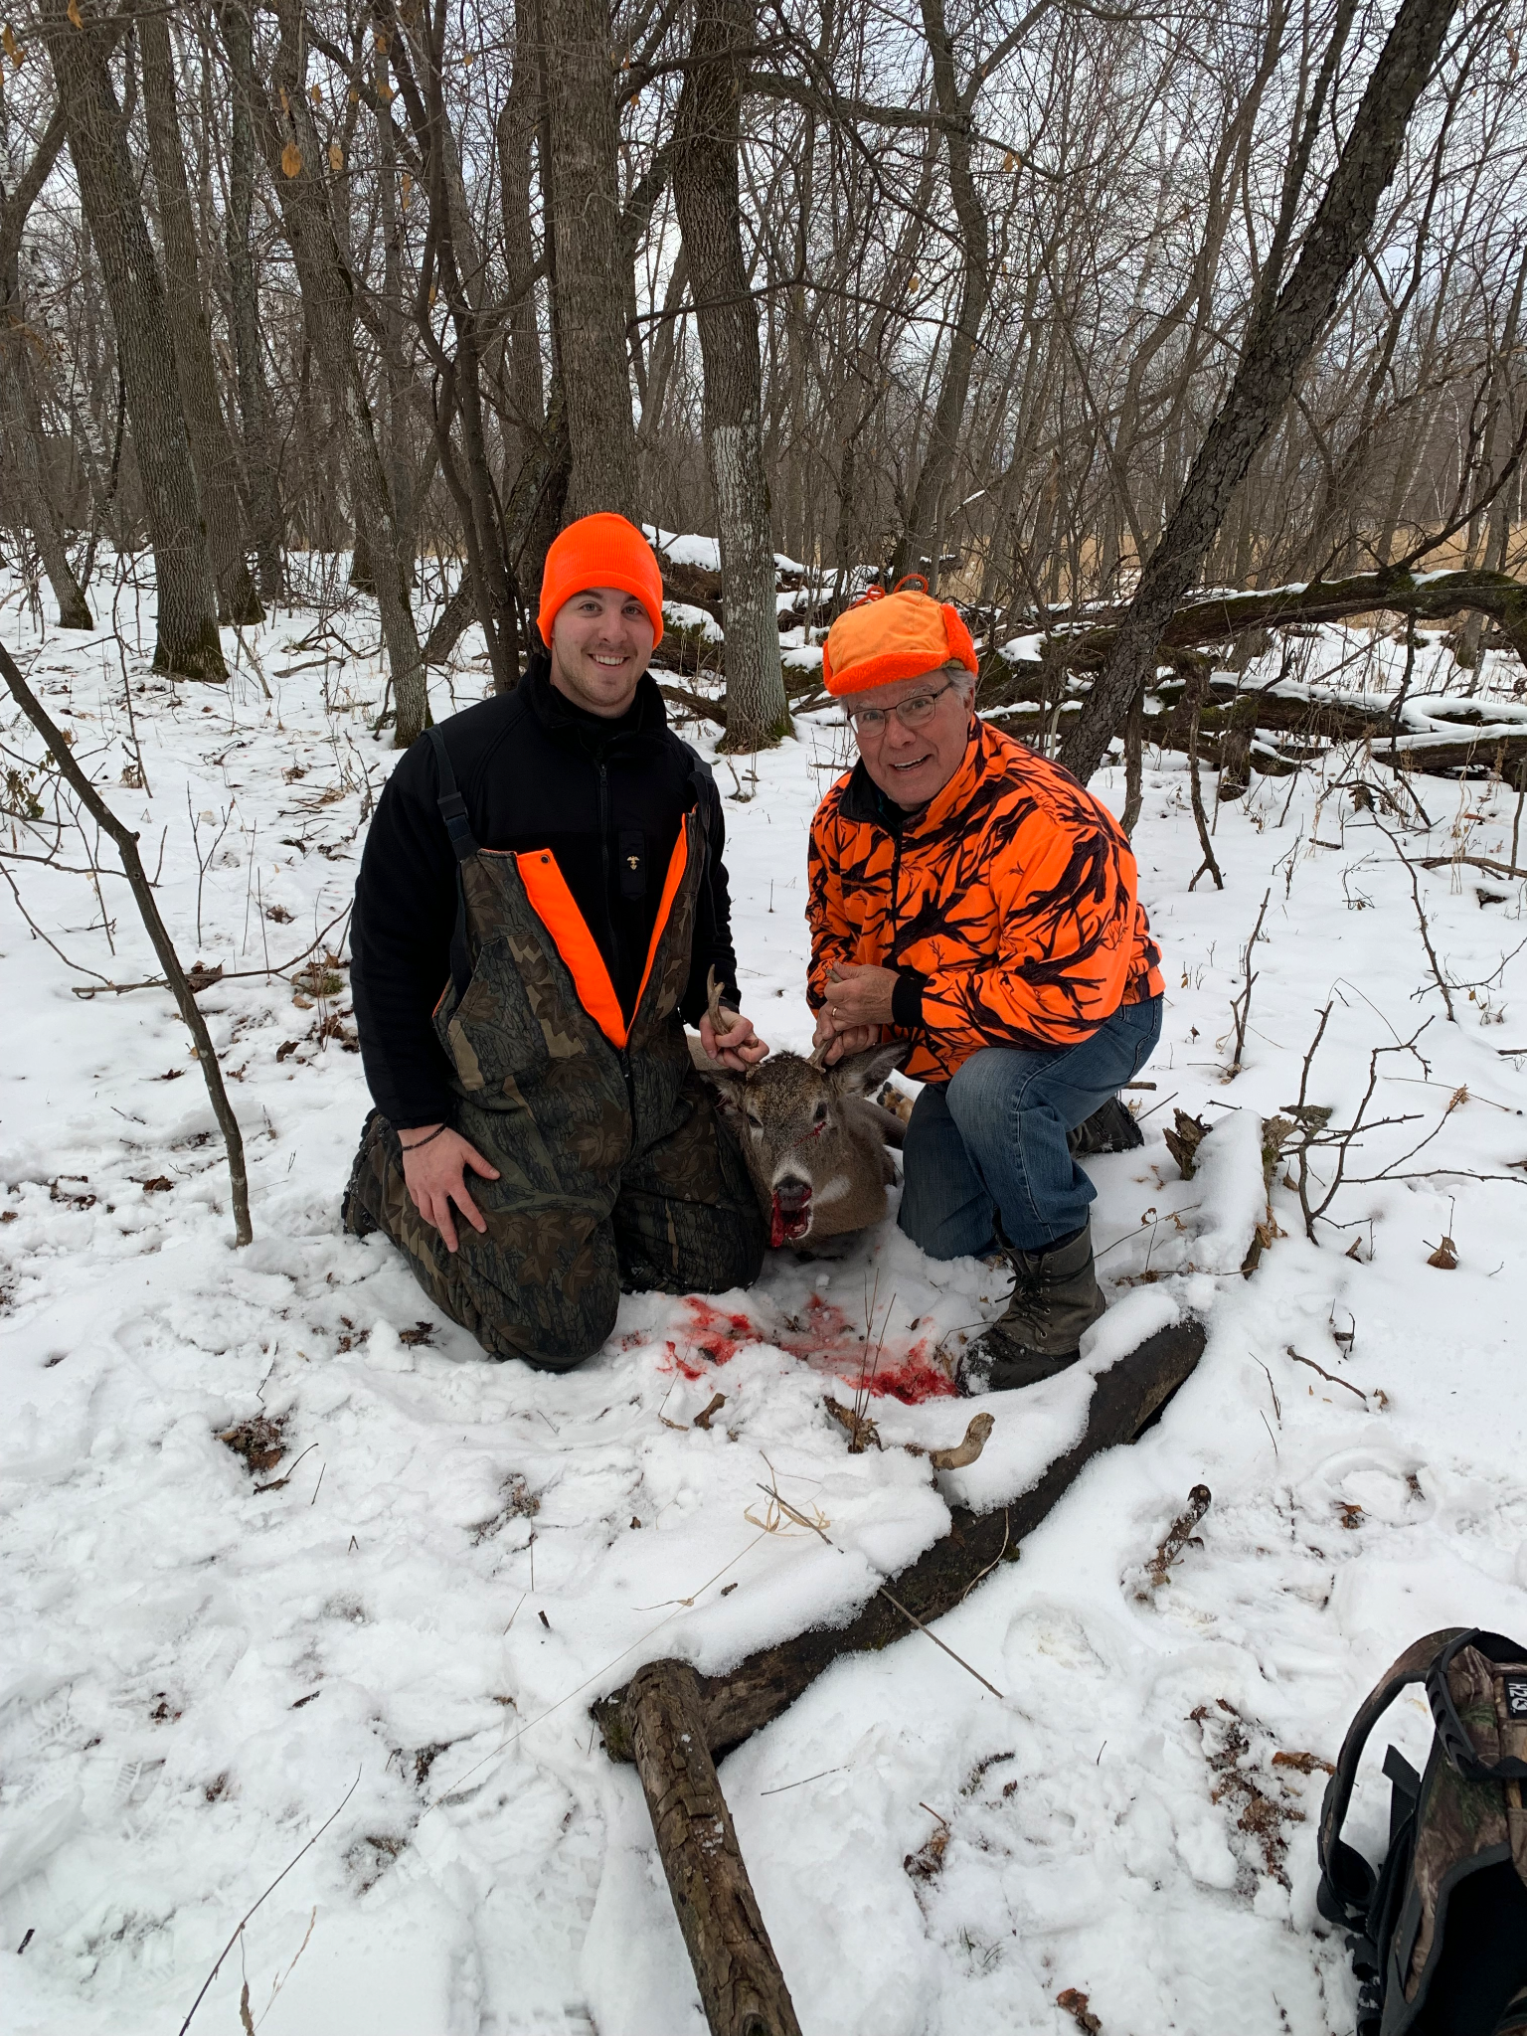
Questions?

